Slide 1

Understanding the Enrollment Rate Drop in Key Accounts Motion
January 31, 2019

Slide 2
KA MOTION ACTIVE RATE
How many are active among those enrolled in the program?
There was a considerable drop in the active rate in the Key Accounts Motion program.
Year Month | Enrolled | Active | Active Rate
July 2017 | 9730 | 6772 | 69.6%
July 2018 | 16672 | 8880 | 53.3%

Slide 3
ACTIVE AMONG ENROLLED
Difference in Demographics
No sizeable differences in demographics between active among enrolled members
Demographic Comparisons
 | July 2017 | July 2018 | Effect Size Magnitude
Age | 45 | 44 | Negligible
Subscriber | 79.2% | 82.3% | Negligible
Median Income | $61,303.21 | $63,288.62 | Negligible

Slide 4
ACTIVE AMONG ENROLLED
Difference in RAF and Condition Prevalence
No sizeable differences in RAF and percentage of prevalence conditions between the groups of active among enrolled members
Prevalence of T2D, hypertension, depression/anxiety, COPD, CHF, RA and chronic pain do not differ
RAF Score and Percentage Prevalence Comparisons
RAF scores of continuously UHC enrolled
 | July 2017 | July 2018 | Effect Size Magnitude
RAF Score | 1.40 | 1.31 | No Difference

Slide 5
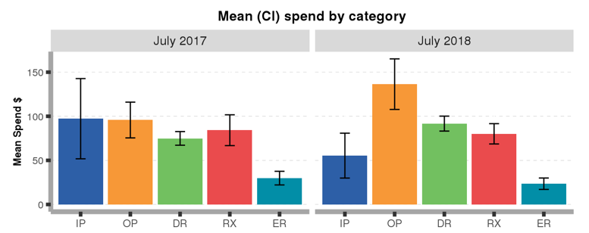
ACTIVE AMONG ENROLLED
Difference in Healthcare Spending
July 2018 and July 2017 had similar spending on healthcare services except for OP and DR.
Healthcare $ Spending Comparisons
$136.4
$91.7
$80.1
$97.3
$95.8
$75.0
$84.2
$29.9
$55.4
$23.5
 | July 2017 | July 2018 | Effect Size Magnitude
Total Allowed Amount | $382.1 | $387.2 | No Difference

Slide 6
ACTIVE AMONG ENROLLED
Difference in PMPM Spending
July 2018 active among enrolled members have higher month on month spending on healthcare
PMPM Spending Comparisons
 | As of July 2017 | As July 2018 | Observed Difference | Bootstrap CI
PMPM | $331.0 | $385.6 | $54.6 | ($7.54, $102.32)

